Slide 1
Themes and Styling
DMIT 2504 Week 3 day 2

Slide 2





Announcements

Slide 3
Expectations
No Late Assignments
No Cheating
Be a good classmate
Don’t go to stupid sites in class
Show up to class

Slide 4

Theming
The overarching style of your application
Colors
Fonts
Sizes
Can be done on a widget or app basis (or both)

Slide 5
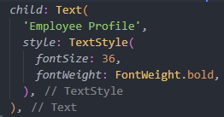
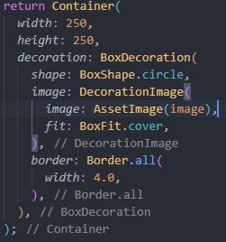
Styling a single Widget
Done through properties
Often the style or decoration property
Must usually pass in some form of Style instance

Slide 6
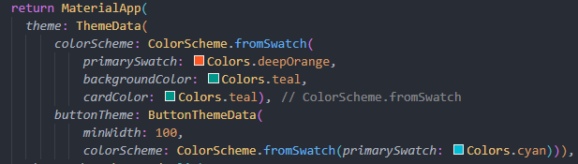
Theme Data and App wide Changes
Default styling for the app can be done in the MaterialApp widget
Assign a ThemeData instance to the theme property
Can pass different ThemeData instances for different widgets in the app

Slide 7


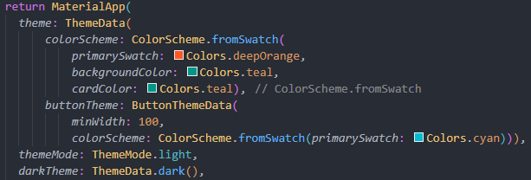
Light and Dark Mode
By default the theme property defines the light mode theme
The darkTheme property defines the dark mode theme
The themeMode property defines the theme mode
ThemeData.dark() and ThemeData.light() include built in themes

Slide 8
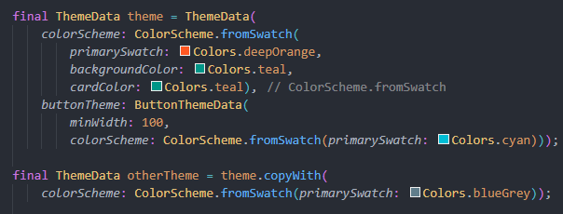
Copy themes
If you want most of a theme but want to change a few things you can use copyWith()

Slide 9
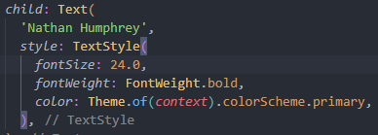
Accessing theme in child widgets
Widgets lower in the widget tree often need access to theme values
Instead of passing theme all the way down you can use Theme.of(context)
This searches up the widget tree for the next available theme to use making use of the Inherited widget type

Slide 10
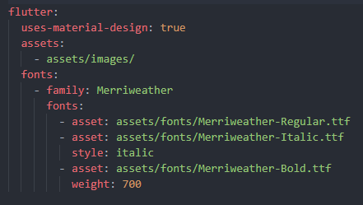
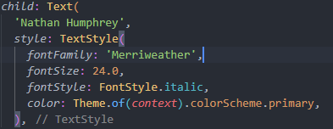
Adding a Font
Get the .ttf files for the font
Put the .ttf files in a folder accessible by your app (assets/fonts/ is a great place)
Add the fonts to your pubspec.yaml as shown in the screenshot
Access the font by using the fontFamily name

